Slide 1
ELEC 5200-001/6200-001
Computer Architecture and Design
Fall 2014
History of Computers (Chapter 1)
Vishwani D. Agrawal
James J. Danaher Professor
Department of Electrical and Computer Engineering
Auburn University, Auburn, AL 36849
http://www.eng.auburn.edu/~vagrawal
vagrawal@eng.auburn.edu
Fall 2014, Aug 20 . . .
ELEC 5200-001/6200-001 Lecture 2

Slide 2
Historic Events
1623, 1642: Wilhelm Schickard (1592-1635) and Blaise Pascal (1623-1662) built mechanical counters with carry.
1823-34: Charles Babbage designed a difference engine. http://www.youtube.com/watch?v=0anIyVGeWOI&feature=related
1941: Conrad Zuse (1910-1995) built Z3, the first working programmable computer, built in Germany.
Fall 2014, Aug 20 . . .
ELEC 5200-001/6200-001 Lecture 2

Slide 3
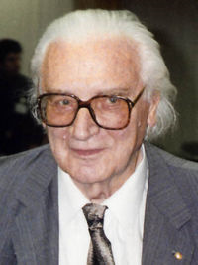
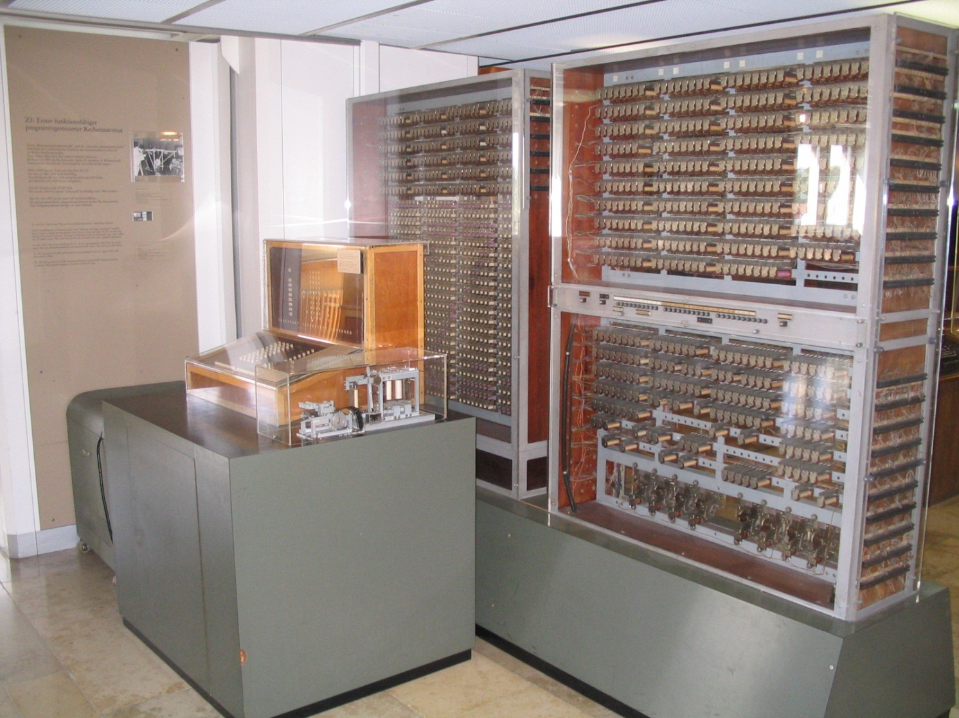
Z3
Conrad Zuse
Z1 (1938)
Z2 (1939)
Z3 (1941)
∙
∙
∙
Fall 2014, Aug 20 . . .
ELEC 5200-001/6200-001 Lecture 2

Slide 4
Historic Events
1942: Vincent Atanasoff (professor) and Clifford Barry (graduate assistant) built the first electronic computer (ABC) at Iowa State College.
1943-44: John Mauchly (professor) and J. Presper Eckert (graduate student) built ENIAC at U. Pennsylvania, 1623.
1944: Howard Aiken used “separate data and program memories” in MARK I – IV computers – Harvard Architecture.
1945-52: John von Neumann proposed a “stored program computer” EDVAC (Electronic Discrete Variable Automatic Computer) – Von Neumann Architecture – use the same memory for program and data.
Fall 2014, Aug 20 . . .
ELEC 5200-001/6200-001 Lecture 2

Slide 5

The Atanasoff Story
The First Electronic Computer, the Atanasoff Story, by Alice R. Burks and Arthur W. Burks, Ann Arbor, Michigan: The University of Michigan Press, 1991.
The Man Who Invented the Computer: The Biography of John Atanasoff, Digital Pioneer, by Jane Smiley, 256 pages, Doubleday, $25.95.
Fall 2014, Aug 20 . . .
ELEC 5200-001/6200-001 Lecture 2

Slide 6
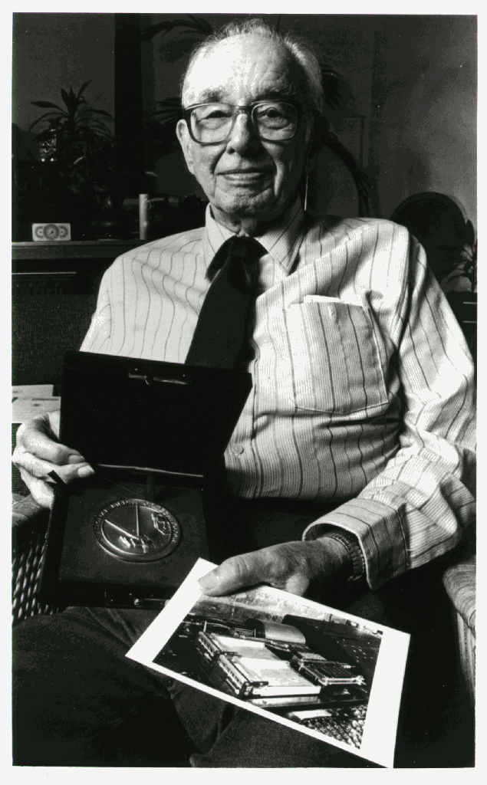
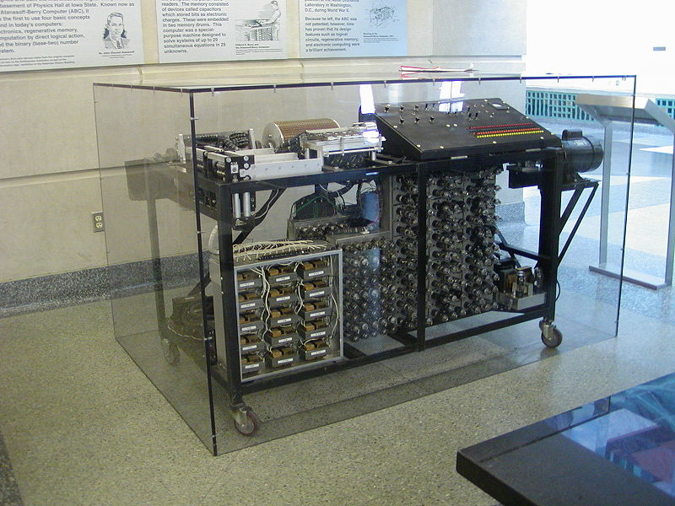
National Medal of Technology 1990
John Vincent Atanasoff (1903–1995)
Fall 2014, Aug 20 . . .
ELEC 5200-001/6200-001 Lecture 2

Slide 7
Most Influential Document
“Preliminary Discussion of the Logical Design of an Electronic Computing Instrument,” 1946 report by A. W. Burks, H. H. Holdstine and J. von Neumann. Appears in Papers of John von Neumann, W. Aspray and A. Burks (editors), MIT Press, Cambridge, Mass., 1987, pp. 97-146.
Fall 2014, Aug 20 . . .
ELEC 5200-001/6200-001 Lecture 2

Slide 8
History Continues
1946-52: Von Neumann built the IAS computer at the Institute of Advanced Studies, Princeton – A prototype for most future computers.
1947-50: Eckert-Mauchly Computer Corp. built UNIVAC I (Universal Automatic Computer), used in the 1950 census.
1949: Maurice Wilkes built EDSAC (Electronic Delay Storage Automatic Calculator), the first stored-program computer.
Fall 2014, Aug 20 . . .
ELEC 5200-001/6200-001 Lecture 2

Slide 9
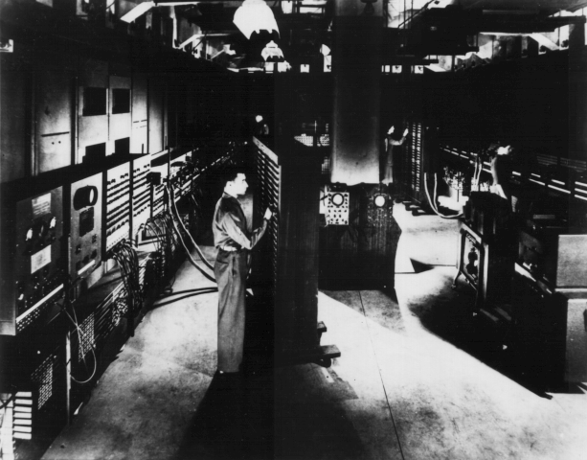
First General-Purpose Computer
Electronic Numerical Integrator and Calculator (ENIAC) built in World War II was the first general purpose computer
  Used for computing artillery firing tables
  80 feet long, 8.5 feet high and several feet wide
  Twenty 10 digit registers, each 2 feet long
  Used 18,000 vacuum tubes
  5,000 additions/second
  Weight: 30 tons
  Power consumption: 140kW
© 2004 Morgan Kaufman Publishers
Fall 2014, Aug 20 . . .
ELEC 5200-001/6200-001 Lecture 2

Slide 10
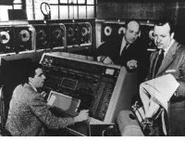
Univac: Election, Nov. 4, 1952
Candidate | Electoral votes
 | Univac prediction | Actual count
Eisenhower | 438 | 442
Stevenson | 93 | 89
Harold Sweeney, operator
J. Presper Eckert, co-inventor
Walter Cronkite, CBS
USA TODAY, Oct 27, 2004, p. B.3
Fall 2014, Aug 20 . . .
ELEC 5200-001/6200-001 Lecture 2

Slide 11
First-Generation Computers
Late 1940s and 1950s
Stored-program computers
Programmed in assembly language
Used magnetic devices and earlier forms of memories
Examples: IAS, ENIAC, EDVAC, UNIVAC, Mark I, IBM 701
Fall 2014, Aug 20 . . .
ELEC 5200-001/6200-001 Lecture 2

Slide 12
The Organization of IAS Computer
Accumulator (AC)
Multiplier/Quotient (MQ)
Input/
Output
Equipment
Arithmetic Logic Circuits
DATAPATH
Memory Buffer Register (MBR)
Instr. Buffer (IBR)
Program Counter (PC)
Main
Memory
(M)
2¹² x 40 bit
words
Instruction Register (IR)
Memory Address Reg. (MAR)
Control
Circuit
Control
Signals
CONTROL UNIT
Fall 2014, Aug 20 . . .
ELEC 5200-001/6200-001 Lecture 2

Slide 13
IAS Computer Machine Language
40-bit word, two machine instructions per word.
Left instruction
Right instruction
bit 0
7 8
19 20
27 28
39
8-bit opcode
12-bit memory address
(operand)
Ref: J. P. Hayes, Computer Architecture and Organization, New York:
McGraw-Hill, 1978.
Fall 2014, Aug 20 . . .
ELEC 5200-001/6200-001 Lecture 2

Slide 14
IAS Data Transfer Instructions (7)
Instruction Opcode Description
LOAD MQ 00001010 AC ← MQ
LOAD MQ, M(X) 00001001 MQ ← M(X)
STOR M(X) 00100001 M(X) ← AC
LOAD M(X) 00000001 AC ← M(X)
LOAD – M(X) 00000010 AC ← – M(X)
LOAD |M(X)| 00000011 AC ← |M(X)|
LOAD – |M(X)| 00000100 AC ← – |M(X)|
Ref. W. Stallings, Computer Organization & Architecture, Sixth Edition,
Prentice-Hall, 2003, page 23.
Fall 2014, Aug 20 . . .
ELEC 5200-001/6200-001 Lecture 2

Slide 15
IAS Unconditional Branch Instructions (2)
Instruction Opcode Description
JUMP M(X,0:19) 00001101 next instruction M(X,0:19)
JUMP M(X,20:39) 00001110 next instruction
M(X,20:39)
Fall 2014, Aug 20 . . .
ELEC 5200-001/6200-001 Lecture 2

Slide 16
IAS Conditional Branch
Instructions (2)
Instruction Opcode Description
JUMP +M(X,0:19) 00001111 IF AC ≥ 0, then next instruction M(X,0:19)
JUMP +M(X,20:39) 00010000 IF AC ≥ 0, then next instruction
M(X,20:39)
Fall 2014, Aug 20 . . .
ELEC 5200-001/6200-001 Lecture 2

Slide 17
IAS Arithmetic Instructions (8)
Instruction Opcode Description
ADD M(X) 00000101 AC ← AC + M(X)
ADD |M(X)| 00000111 AC ← AC + |M(X)|
SUB M(X) 00000110 AC ← AC ─ M(X)
SUB |M(X)| 00001000 AC ← AC ─ |M(X)|
MUL M(X) 00001011 AC, MQ ← MQ×M(X)
DIV M(X) 00001100 MQ, AC ← MQ/M(X)
LSH 00010100 AC ← AC x 2
RSH 00010101 AC ← AC / 2
Fall 2014, Aug 20 . . .
ELEC 5200-001/6200-001 Lecture 2

Slide 18
IAS Address Modify Instructions (2)
Instruction Opcode Description
STOR M(X,8:19) 00010010 M(X,8:19) ← AC(28:39)
STOR M(X,28:39) 00010011 M(X,28:39) ← AC(28:39)
Fall 2014, Aug 20 . . .
ELEC 5200-001/6200-001 Lecture 2

Slide 19
How IAS Computer Adds Two Numbers
Suppose the numbers are stored in memory locations 100 and 101, and
The sum is to be saved in memory location 102
Instruction Opcode Description
LOAD M(100) 00000001 AC ← M(100)
ADD M(101) 00000101 AC ← AC + M(101)
STOR M(102) 00100001 M(102) ← AC
Fall 2014, Aug 20 . . .
ELEC 5200-001/6200-001 Lecture 2

Slide 20
IAS Computer Machine Code
00000001 000001100100 00000101 000001100101
Load 100 Add 101
00100001 000001100110 00000000 000000000000
Stor 102 Stop
Fall 2014, Aug 20 . . .
ELEC 5200-001/6200-001 Lecture 2

Slide 21
Save Program in Memory
Address 0
First program word
Second program word
Address
Memory
Load program
Counter, PC
Word 100
Word 101
Word 102
Address max
Fall 2014, Aug 20 . . .
ELEC 5200-001/6200-001 Lecture 2

Slide 22
Executing the Program
Accumulator (AC)
Multiplier/Quotient (MQ)
Input/
Output
Equipment
Arithmetic Logic Circuits
DATAPATH
Memory Buffer Register (MBR)
Instr. Buffer (IBR)
Program Counter (PC)
Main
Memory
(M)
2¹² x 40 bit
words
Instruction Register (IR)
Memory Address Reg. (MAR)
Control
Circuit
Control
Signals
CONTROL UNIT
Fall 2014, Aug 20 . . .
ELEC 5200-001/6200-001 Lecture 2

Slide 23
IAS Instruction Cycles
Store machine code in contiguous words of memory.
Place starting address in program counter (PC).
Start program: MAR ← PC
Read memory: IBR ← MBR ← M(MAR), fetch
Place left instruction (Load) in IR and operand (address) 100 in MAR, decode
Read memory: AC ← M(100), execute
Place right instruction (Add) in IR and operand (address) 101 in MAR, decode
Read memory and add: AC ← AC + M(101), execute
PC ← PC + 1
Fall 2014, Aug 20 . . .
ELEC 5200-001/6200-001 Lecture 2

Slide 24
IAS Instruction Cycles (Cont.)
MAR ← PC
Read memory: IBR ← MBR ← M(MAR), fetch
Place left instruction (Stor) in IR and operand (address) 102 in MAR, decode
MBR ← AC, execute
Write memory
Place right instruction (Stop) in IR and operand 000 in MAR, decode
Stop, execute
Fall 2014, Aug 20 . . .
ELEC 5200-001/6200-001 Lecture 2

Slide 25

Hardware Contains
Data storage devices
    Memory
    Registers
Instruction decoding and execution devices
    Execution unit (arithmetic logic unit, ALU)
    Data transfer buses
    Control unit
Fall 2014, Aug 20 . . .
ELEC 5200-001/6200-001 Lecture 2

Slide 26
Registers in IAS
Register | Size(bits) | Function
Program counter (PC) | 12 | Holds mem. address of next instruction
Accumulator (AC) | 40 | Temporary data storage
Multiplier quotient (MQ) | 40 | Temporary data storage
Memory buffer (MBR) | 40 | Memory read / write data
Instruction buffer (IBR) | 20 | Holds right instr. (bits 20-39)
Instruction register (IR) | 8 | Holds opcode part of instruction
Memory address (MAR) | 12 | Holds mem. address part of instruction
Fall 2014, Aug 20 . . .
ELEC 5200-001/6200-001 Lecture 2

Slide 27
Register Transfer
Transfer data synchronously with clock
    Register to register
    Register to register through ALU logic
    Registers to register through memory (write)
    Register to register through memory (read)
Data transfer through communication bus
    Source register writes on bus
    Destination register reads from bus
    Control circuit provides read / write signals for bus and memory
Fall 2014, Aug 20 . . .
ELEC 5200-001/6200-001 Lecture 2

Slide 28
Communication Bus
A device writing
on bus
outputs inputs
A device neither
writing on nor
reading from bus
outputs inputs
1
0
0
0
Bus
Control signals
0
1
Control
circuit
outputs inputs
A device reading
from bus
Control
signals
Opcode
Fall 2014, Aug 20 . . .
ELEC 5200-001/6200-001 Lecture 2

Slide 29
Control Circuit – Finite State Machine
Start
MAR ← PC
PC ← PC+1
Read
memory
Decode
left
instruction
Fetch Instruction
Execute
Decode
right
instruction
Execute
Fall 2014, Aug 20 . . .
ELEC 5200-001/6200-001 Lecture 2

Slide 30
Von Neumann Bottleneck
Von Neumann architecture uses the same memory for instructions (program) and data.
The time spent in memory accesses can limit the performance. This phenomenon is referred to as von Neumann bottleneck.
To avoid the bottleneck, later architectures restrict most operands to registers (temporary storage in processor).
Ref.: D. E. Comer, Essentials of Computer Architecture, Upper Saddle
River, NJ: Pearson Prentice-Hall, 2005, p. 87.
Fall 2014, Aug 20 . . .
ELEC 5200-001/6200-001 Lecture 2

Slide 31
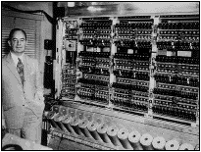
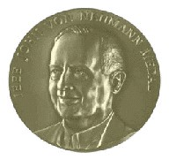
John von Neumann (1903-1957)
Fall 2014, Aug 20 . . .
ELEC 5200-001/6200-001 Lecture 2

Slide 32
Second Generation Computers
1955 to 1964
Transistor replaced vacuum tubes
Magnetic core memories
Floating-point arithmetic
High-level languages used: ALGOL, COBOL and FORTRAN
System software: compilers, subroutine libraries, batch processing
Example: IBM 7094
Fall 2014, Aug 20 . . .
ELEC 5200-001/6200-001 Lecture 2

Slide 33
Third Generation Computers
Beyond 1965
Integrated circuit (IC) technology
Semiconductor memories
Memory hierarchy, virtual memories and caches
Time-sharing
Parallel processing and pipelining
Microprogramming
Examples: IBM 360 and 370, CYBER, ILLIAC IV, DEC PDP and VAX, Amdahl 470
Fall 2014, Aug 20 . . .
ELEC 5200-001/6200-001 Lecture 2

Slide 34
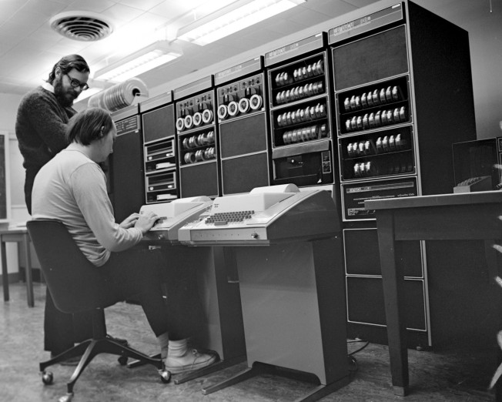
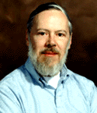

C Programming Language and UNIX Operating System
1972
Now
Fall 2014, Aug 20 . . .
ELEC 5200-001/6200-001 Lecture 2

Slide 35
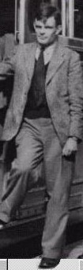
Theory of Computing
Alan Turing (1912-1954) gave a model of computing in 1936 – Turing Machine.
Original paper: A. M. Turing, “On Computable Numbers with an Application to the Entscheidungsproblem*,” Proc. Royal Math. Soc., ser. 2, vol. 42, pp. 230-265, 1936.
Recent book: David Leavitt, The Man Who Knew Too Much: Alan Turing and the Invention of the Computer (Great Discoveries), W. W. Norton & Co., 2005.
* The question of decidability, posed by mathematician Hilbert.
Fall 2014, Aug 20 . . .
ELEC 5200-001/6200-001 Lecture 2

Slide 36
Turing Machine
Processor
P
Read-write head
t_{i}
Infinite memory tape (data)
Machine instruction: s_{h} t_{i} o_{j} s_{k}
Present state of processor
Symbol on tape
Operation
Next state of processor
Fall 2014, Aug 20 . . .
ELEC 5200-001/6200-001 Lecture 2

Slide 37
Turing Machine
Four operations:
  o_{j} = t_{j}, replace present symbol t_{i} by t_{j}
  o_{j} = R, move head one position to right
  o_{j} = L, move head one position to left
  o_{j} = H, halt the computation
Universal Turing Machine: small instruction set, #symbols × #states < 30; can perform any possible (computable) computation.
Computable means that Turing machine halts in finite number of steps.
Real computers have finite memory – they find certain problems intractable.
Ref: J. P. Hayes, Computer Architecture and Organization, New York: McGraw-Hill, 1978.
Fall 2014, Aug 20 . . .
ELEC 5200-001/6200-001 Lecture 2

Slide 38
Example
Start with a blank tape and create a pattern 0b1b0b1b . . .
Define symbols: b (blank), 0, 1
Present state | Symbol on tape | Operation | Next state
S0 (begin) | blank | Write 0 and move right | S1
S1 | blank | Move right | S2
S2 | blank | Write 1 and move right | S3
S3 | blank | Move right | S0
http://en.wikipedia.org/wiki/Turing_machine_examples
Fall 2014, Aug 20 . . .
ELEC 5200-001/6200-001 Lecture 2

Slide 39
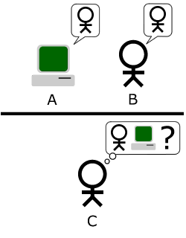
Turing Test
Can a computer think? (Turing, 1950).
http://en.wikipedia.org/wiki/Computing_Machinery_and_Intelligence#cite_note-1
A. P. Saygin, I. Cicekli and V. Akman, “Turing Test: 50 Years Later,” Minds and Machines, vol. 10, no. 4, pp. 463-518, 2000.
Watson vs. humans:
http://www.engadget.com/2011/01/13/ibms-watson-supercomputer-destroys-all-humans-in-jeopardy-pract/
Fall 2014, Aug 20 . . .
ELEC 5200-001/6200-001 Lecture 2

Slide 40
Turing Test in 2014
June 8, 2014, The 65 year-old Turing Test was passed for the very first time by computer program Eugene Goostman during Turing Test 2014 held at the renowned Royal Society in London on Saturday.
'Eugene' simulates a 13 year old boy and was developed in Saint Petersburg, Russia. The development team includes Vladimir Veselov and Eugene Demchenko.
A program wins the Turing Test if it is mistaken for a human more than 30% of the time.
http://www.reading.ac.uk/news-and-events/releases/PR583836.aspx
Fall 2014, Aug 20 . . .
ELEC 5200-001/6200-001 Lecture 2

Slide 41
Movie: The Imitation Game
About English mathematician and logician, Alan Turing, helps crack the Enigma code during World War II.
Screenplay: Graham Moore
Cast: Benedict Cumberbatch, Keira Knightley, Matthew Goode
Trailer: http://www.imdb.com/title/tt2084970/?ref_=nv_sr_1
Release date: November 2014
Fall 2014, Aug 20 . . .
ELEC 5200-001/6200-001 Lecture 2

Slide 42
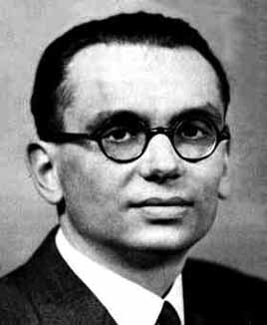
Incompleteness Theorem
In 1931, the Czech-born mathematician Kurt Gödel (1906-1978) demonstrated that within any given branch of mathematics, there would always be some propositions that couldn't be proven either true or false using the rules and axioms.
Gödel's Theorem has been used to argue that a computer can never be as smart as a human being because the extent of its knowledge is limited by a fixed set of axioms, whereas people can discover unexpected truths.
See http://www.miskatonic.org/godel.html and other websites.
Fall 2014, Aug 20 . . .
ELEC 5200-001/6200-001 Lecture 2

Slide 43
The Barber Paradox
By Linda Shaver
(An Example of Undecidability)
In a particular town, there’s a particular barbershop with a peculiar sign in the window that reads:
“This barber shaves all and only those men of
the town who do not shave themselves.”
Question: According to the sign in the window, does the barber shave himself?
Fall 2014, Aug 20 . . .
ELEC 5200-001/6200-001 Lecture 2

Slide 44
The Now Generation
Personal computers
Laptops and Palmtops
Networking and wireless
SOC and MEMS technology
And the future!
    Biological computing
    Molecular computing
    Nanotechnology
    Optical computing
    Quantum computing
    See articles listed on the next slide and available at E7700: Advanced VLSI Design course site, http://www.eng.auburn.edu/~vagrawal/COURSE/E7770_Spr12/course.html
Fall 2014, Aug 20 . . .
ELEC 5200-001/6200-001 Lecture 2

Slide 45
Useful Reading
R. I. Bahar, D. Hammerstrom, J. Harlow, W. H. Joyner Jr., C. Lau, D. Marculescu, A. Orailoglu and M. Pedram, “Architectures for Silicon Nanoelectronics and Beyond,” Computer, vol. 40, no. 1, pp. 25-33, January 2007.
T. Munakata, “Beyond Silicon: New Computing Paradigms, “Comm. ACM, vol. 50, no. 9, pp. 30-34, Sept. 2007.
W. Robinett, G. S. Snider, P. J. Kuekes and S. Williams, “Computing with a Trillion Crummy Components,” Comm. ACM, vol. 50, no. 9, pp. 35-39, Sept. 2007.
J. Kong, “Computation with Carbon Nanotube Devices,” Comm. ACM, vol. 50, no. 9, pp. 40-42, Sept. 2007.
R. Stadler, “Molecular, Chemical and Organic Computing,” Comm. ACM, vol. 50, no. 9, pp. 43-45, Sept. 2007.
M. T. Bohr, R. S. Chau, T. Ghani and K. Mistry, "The High-k Solution," IEEE Spectrum, vol. 44, no. 10, pp. 29-35, October 2007.
J. H. Reif and T. H. Labean, “Autonomous Programmable Biomolecular Devices using Self-Assembled DNA Nanostructures,” Comm. ACM, vol. 50, no. 9, pp. 46-53, Sept. 2007.
D. Bacon and D. Leung, “Toward a World with Quantum Computers,” Comm. ACM, vol. 50, no. 9, pp. 55-59, Sept. 2007.
H. Abdeldayem and D. A. Frazier, “Optical Computing: Need and Challenge,” Comm. ACM, vol. 50, no. 9, pp. 60-62, Sept. 2007.
D. W. M. Marr and T. Munakata, “Micro/Nanofluidic Computing,” Comm. ACM, vol. 50, no. 9, pp. 64-68, Sept. 2007.
M. Aono, M. Hara and K. Aihara, “Amoeba-Based Neurocomputing with Chaotic Dynamics,” Comm. ACM, vol. 50, no. 9, pp. 69-72, Sept. 2007.
C. C. Lo and J. J. L. Morton, “Silicon’s Second Act, Can this semiconductor workhorse take computing tnto the quantum era?” IEEE Spectrum, vol. 51, no. 8, pp. 36-43, Aug. 2014.
Fall 2014, Aug 20 . . .
ELEC 5200-001/6200-001 Lecture 2

Slide 46
A Question
Which is the most popular programming language today?
A: http://spectrum.ieee.org/static/interactive-the-top-programming-languages
Fall 2014, Aug 20 . . .
ELEC 5200-001/6200-001 Lecture 2

Slide 47
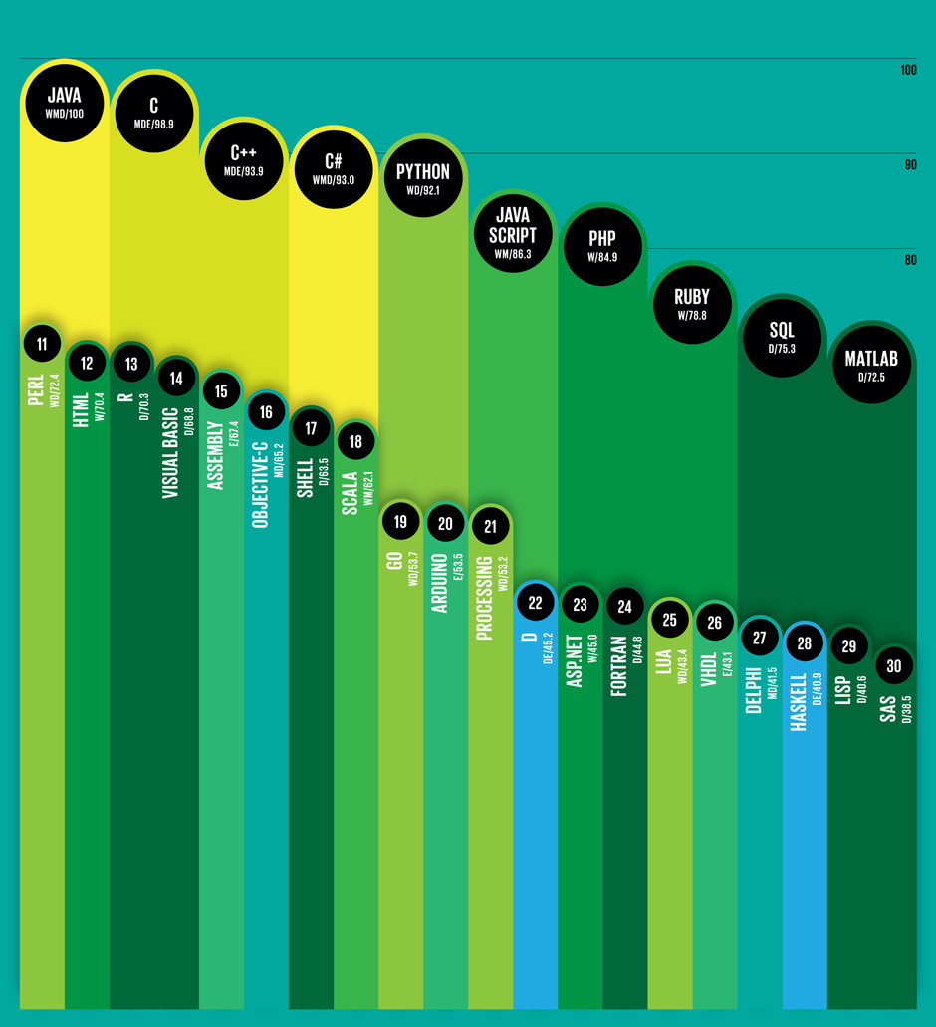
Top 10 Prog. Languages
W: Web
M: Mobile
D: Desktop/Enterprise
E: Embedded
Scores are normalized so that the top-ranked language’s score is set to 100.
Source:
IEEE Spectrum
July 2014
Fall 2014, Aug 20 . . .
ELEC 5200-001/6200-001 Lecture 2

Slide 48
Next: The MIPS ISA
MIPS (Microprocessor without Interlocked Pipeline Stages) is a reduced instruction set architecture.
Fall 2014, Aug 20 . . .
ELEC 5200-001/6200-001 Lecture 2

